Slide 1

Welcome!
Historical adventures in mathematical modelling:
From the Outback to the Arctic
Dr Ems Lord
ell35@cam.ac.uk
nrich.maths.org
© University of Cambridge

Slide 2
Before going back in time, let’s think about now
Which are the three most popular pets in the UK?
nrich.maths.org
© University of Cambridge

Slide 3
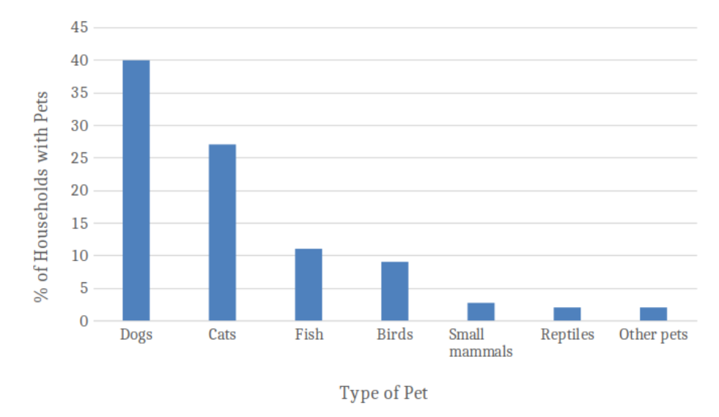
Australia’s favourite pet data:
What do you notice?
nrich.maths.org
© University of Cambridge
https://kb.rspca.org.au/knowledge-base/how-many-pets-are-there-in-australia/

Slide 4
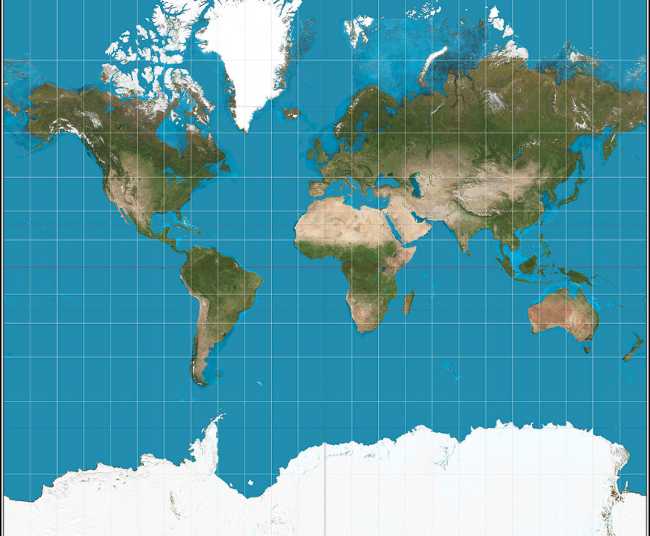
The Australian Outback
nrich.maths.org
© University of Cambridge
https://kb.rspca.org.au/knowledge-base/how-many-pets-are-there-in-australia/

Slide 5
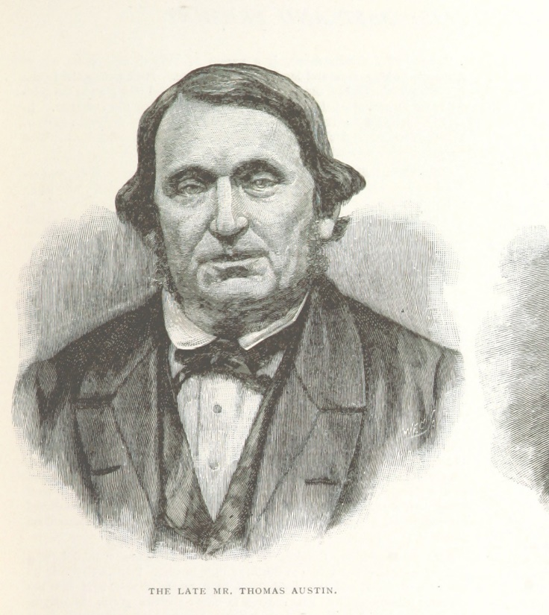
The story of Thomas Austin
In 1859, Thomas Austin introduced 24 breeding rabbits to his Australian outback ranch.
What happened next?
nrich.maths.org
© University of Cambridge
Illustration source: Wikipedia

Slide 6
How accurate is our model?
In 1859 there were 24 rabbits
They spread out at a rate of 70 miles each year
By 1940s there were approx. 800 million
nrich.maths.org
© University of Cambridge

Slide 7
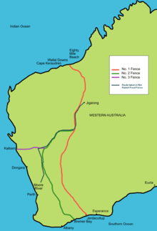
How did the Australians attempt to control their rabbits?
Answer: They built the world’s longest fence
(1,139 miles)
nrich.maths.org
© University of Cambridge
Picture source: Wikipedia

Slide 8

The Standing Disease
nrich.maths.org
© University of Cambridge
nrich.maths.org/1219

Slide 9
The Standing Disease
1
4
16
2
8
nrich.maths.org
© University of Cambridge

Slide 10

1
2
4
8
16
32
64
128
256
512
1,024
2,048
4,096
8,192
16,384
32,768
65,536
131,072
262,144
524,288
1,048,576
2,097,152
4,194,304
8,388,608
16,777,216
33,554,432
67,108,864
134,217,728
268,435,456
536,870,912
1,073,741,824
2,147,483,648
4,294,967,296
8,589,934,592
33 steps!

Slide 11
Interpreting a model…
“Eyebrows were raised when the Centers for Disease Control’s model forecast 77 trillion cases if the epidemic went unchecked”
Ben Cooper (2006)
nrich.maths.org
© University of Cambridge

Slide 12
The Scottish Islands
nrich.maths.org
© University of Cambridge
https://kb.rspca.org.au/knowledge-base/how-many-pets-are-there-in-australia/

Slide 13
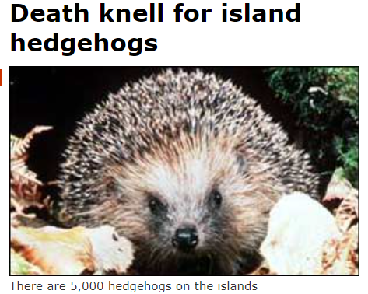
What assumptions might you make?
nrich.maths.org
© University of Cambridge
https://www.statista.com/statistics/308218/leading-ten-pets-ranked-by-household-ownership-in-the-united-kingdom-uk/

Slide 14
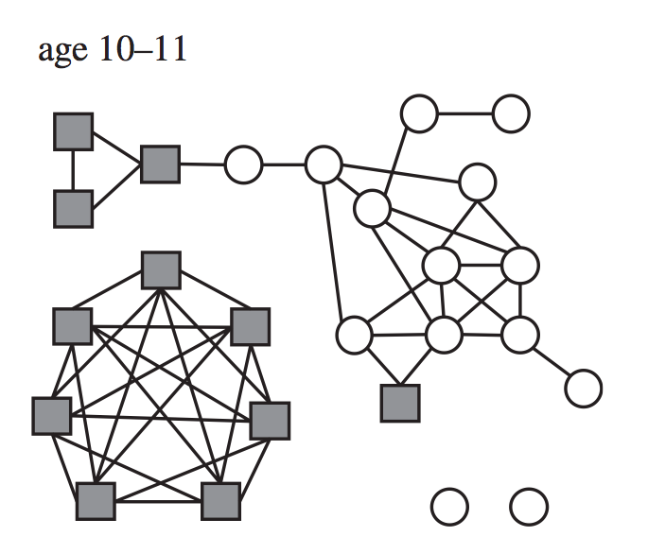
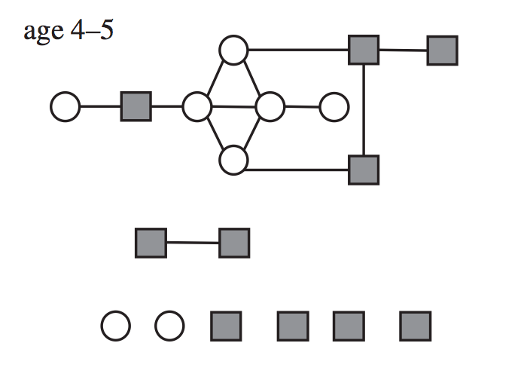
Epidemics on networks
nrich.maths.org/12123
nrich.maths.org
© University of Cambridge

Slide 15
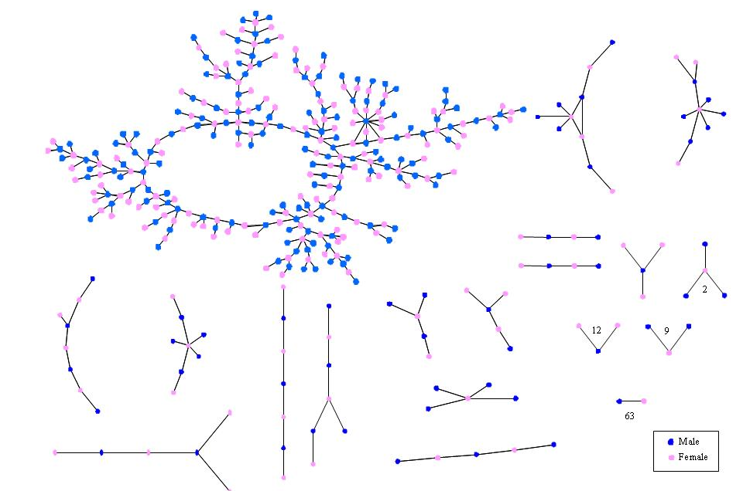
Teenage romantic network

Slide 16
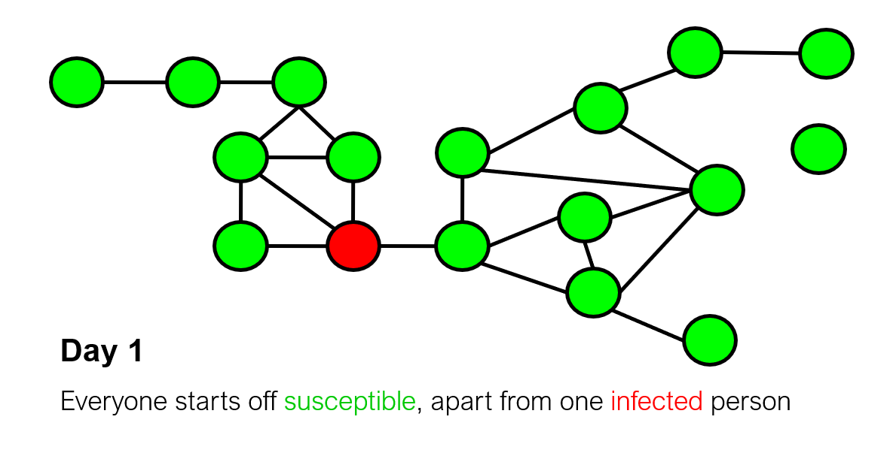
How does an epidemic spread on a netwok?
nrich.maths.org
© University of Cambridge

Slide 17
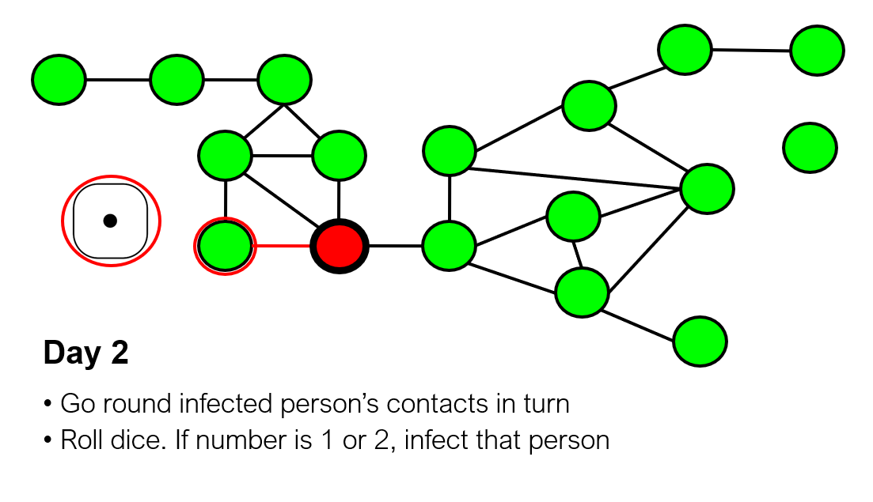
nrich.maths.org
© University of Cambridge

Slide 18
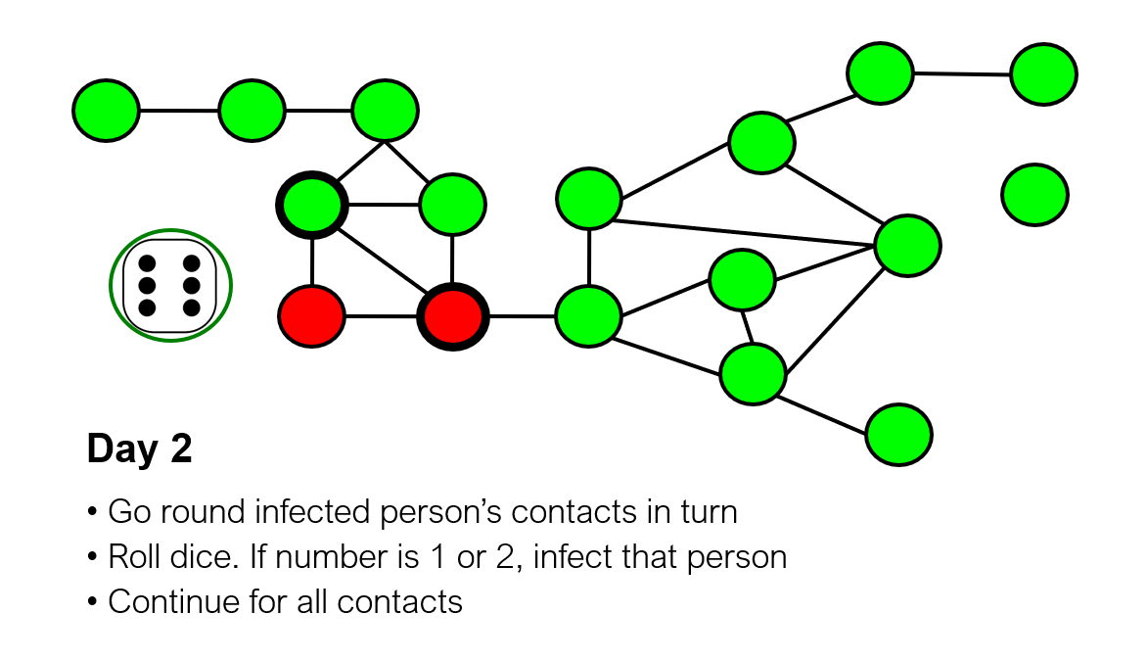
nrich.maths.org
© University of Cambridge

Slide 19
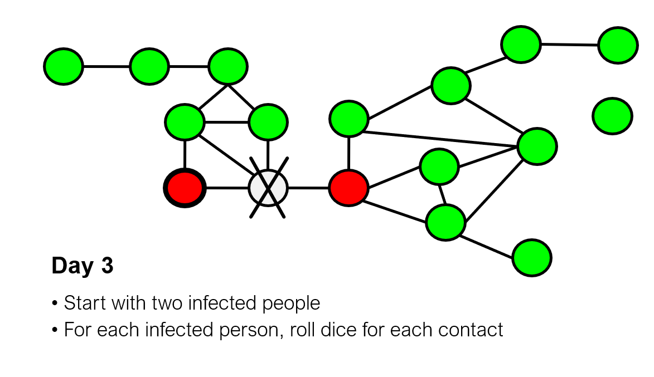

Slide 20
Hudson Bay, Canada
nrich.maths.org
© University of Cambridge

Slide 21
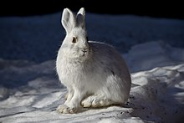
What do you notice?
Starting in 1901, here is the annual list of hares (x 1k):
30, 47, 70, 77, 36, 21, 18, 21, 22, 25, 27, 40, 57, 77, 52, 20, 11, 8, 15, 16, 25
Picture source: Wikipedia
nrich.maths.org
© University of Cambridge

Slide 22
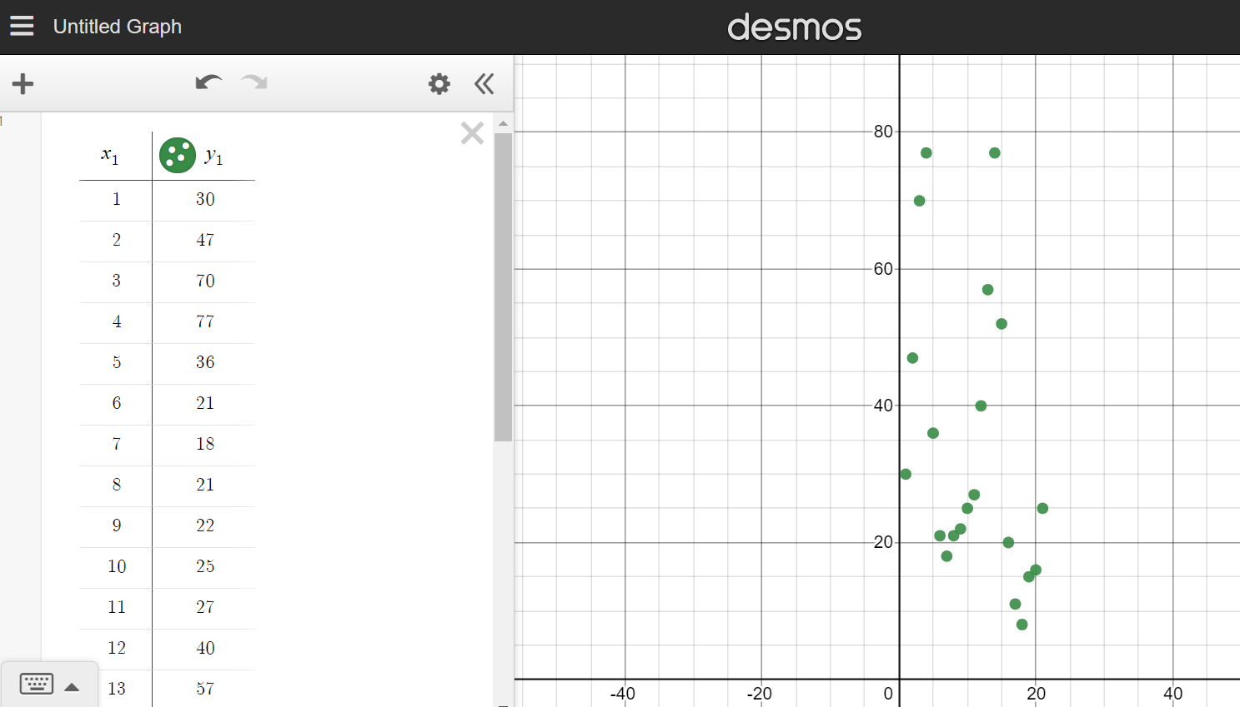
Hudson Bay: Hare data 190 onwards
nrich.maths.org
© University of Cambridge

Slide 23
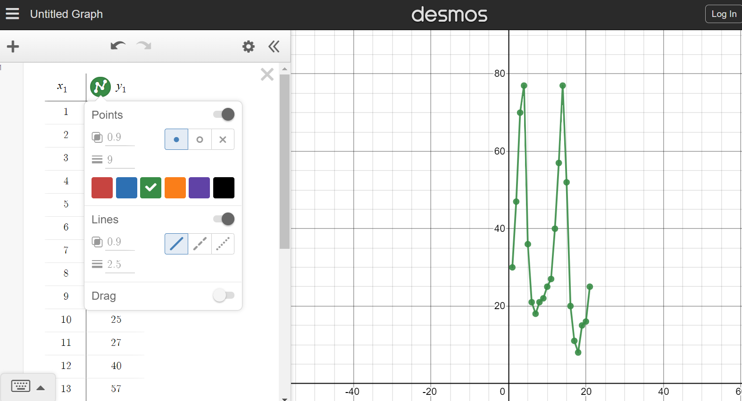
Hudson Bay: Hare data 190 onwards
nrich.maths.org
© University of Cambridge

Slide 24
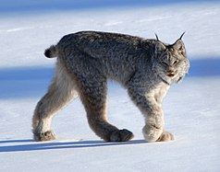
Introducing a predator
Here are the annual figures for the lynx:
4, 6, 10, 35, 59, 42, 19, 13, 8, 9, 7, 8, 12, 20, 46, 51, 30, 16, 10, 10, 9
nrich.maths.org
© University of Cambridge
Picture source: Wikipedia

Slide 25
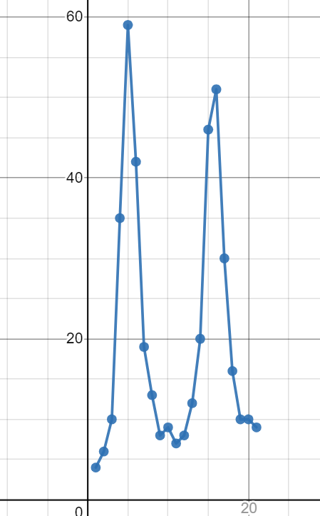
Lynx graph
nrich.maths.org
© University of Cambridge

Slide 26
What do you notice?
Hare | Lynx
30 | 4
47 | 6
70 | 10
77 | 35
36 | 59
21 | 42
18 | 19
21 | 13
22 | 8
25 | 9
27 | 7
nrich.maths.org
© University of Cambridge
Picture source: Wikipedia

Slide 27
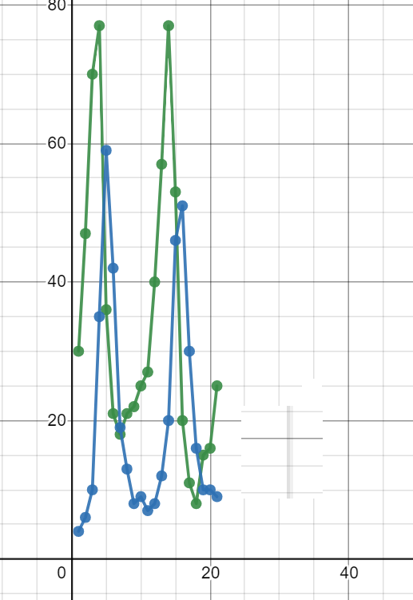
Visual comparison
nrich.maths.org
© University of Cambridge

Slide 28
Adriatic Sea
nrich.maths.org
© University of Cambridge

Slide 29
What do you notice
Here are the figures for the annual % of predators found in fishing nets
12, 21, 22, 21, 36, 27, 16, 16, 15, 11
nrich.maths.org
© University of Cambridge

Slide 30
Predator-prey model
Lotka-Volterra model:
A pair of differential equations
nrich.maths.org
© University of Cambridge

Slide 31
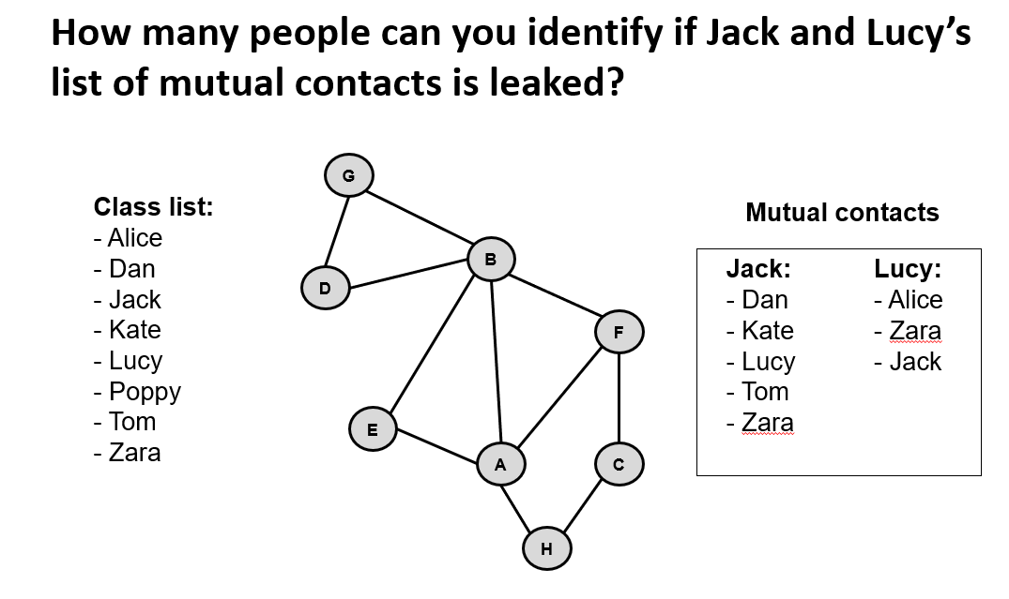
What about confidentiality?
nrich.maths.org/12125
nrich.maths.org
© University of Cambridge

Slide 32
What about ethics?
Iceland and Biobanks
Federal Drug Agency: 23 and me
Ebola vaccine trials
Antibiotic resistance
nrich.maths.org/12122
nrich.maths.org
© University of Cambridge

Slide 33
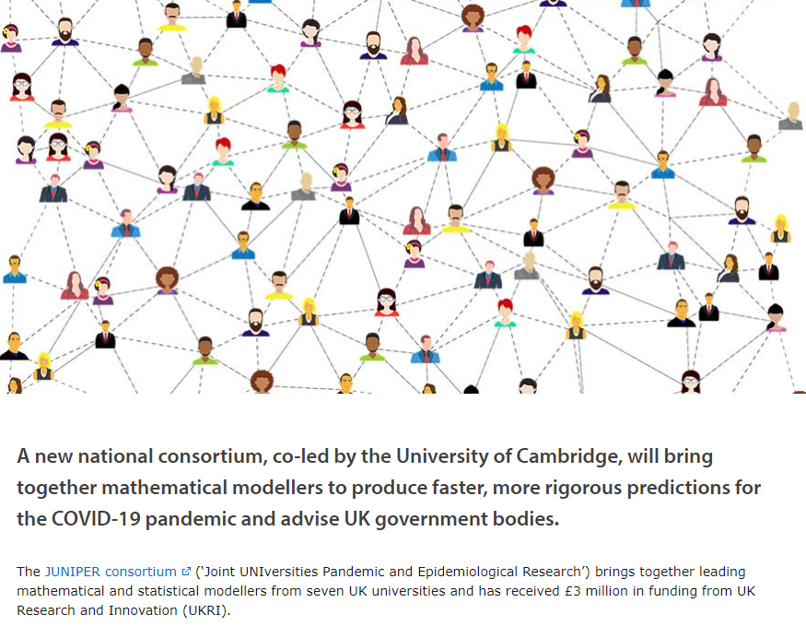
Next steps: JUNIPER
maths.org/juniper/
nrich.maths.org
© University of Cambridge

Slide 34
Taking things further (ID 14880)
NRICH:
Live Problems to explore nrich.maths.org/
Disease Dynamics nrich.maths.org/epidemic
Population Dynamics nrich.maths.org/7252
STEP Support Programme:
Modules to work through (including differential equations!) maths.org/step/welcome
PLUS: Covid feature and regular news updates plus.maths.org/content/covid-19
nrich.maths.org
© University of Cambridge

